Slide 1

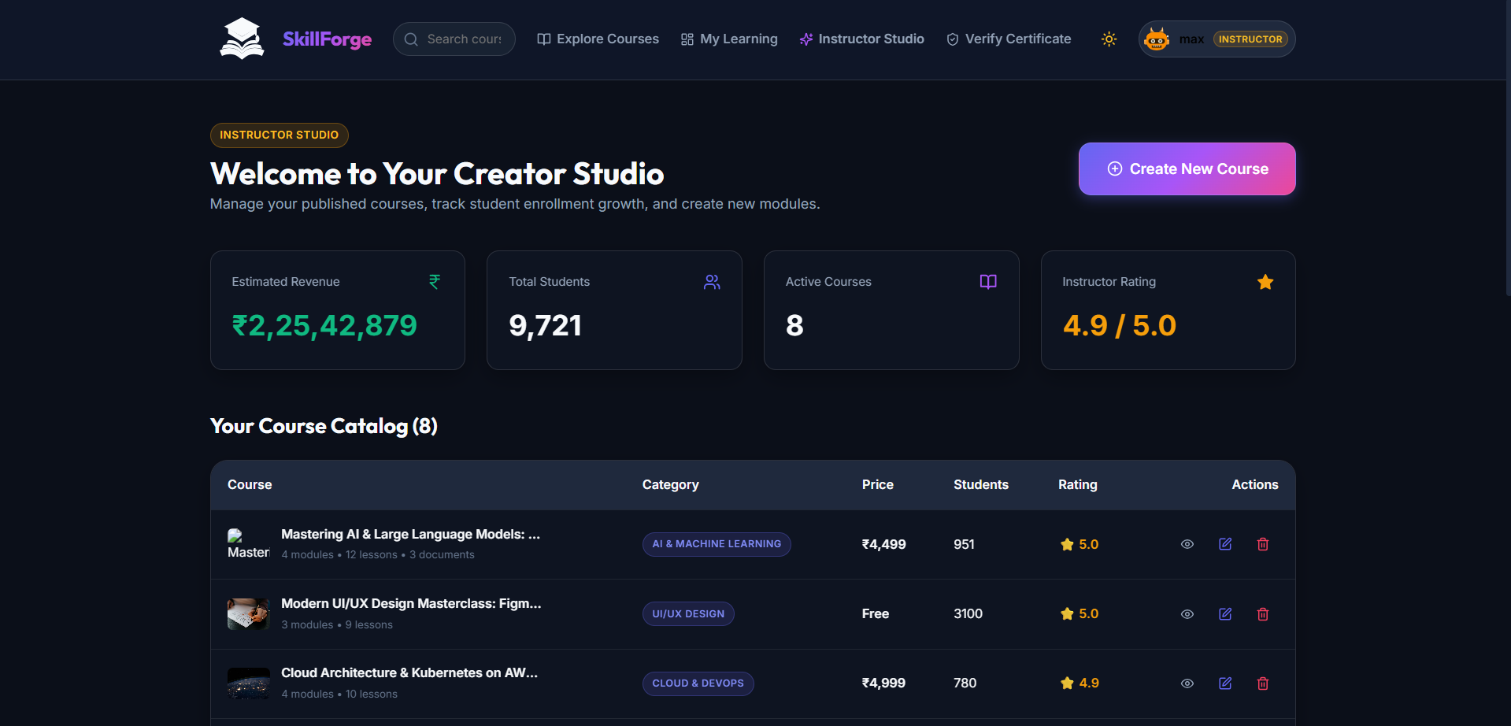
SKILLFORGE
FINAL PROJECT REVIEW
LearnHub
Online Learning Platform
Team15 - Digita-minds
Kalasalingam Academy of Research and Education
B.Tech CSE AIML - 4th Year

Slide 2

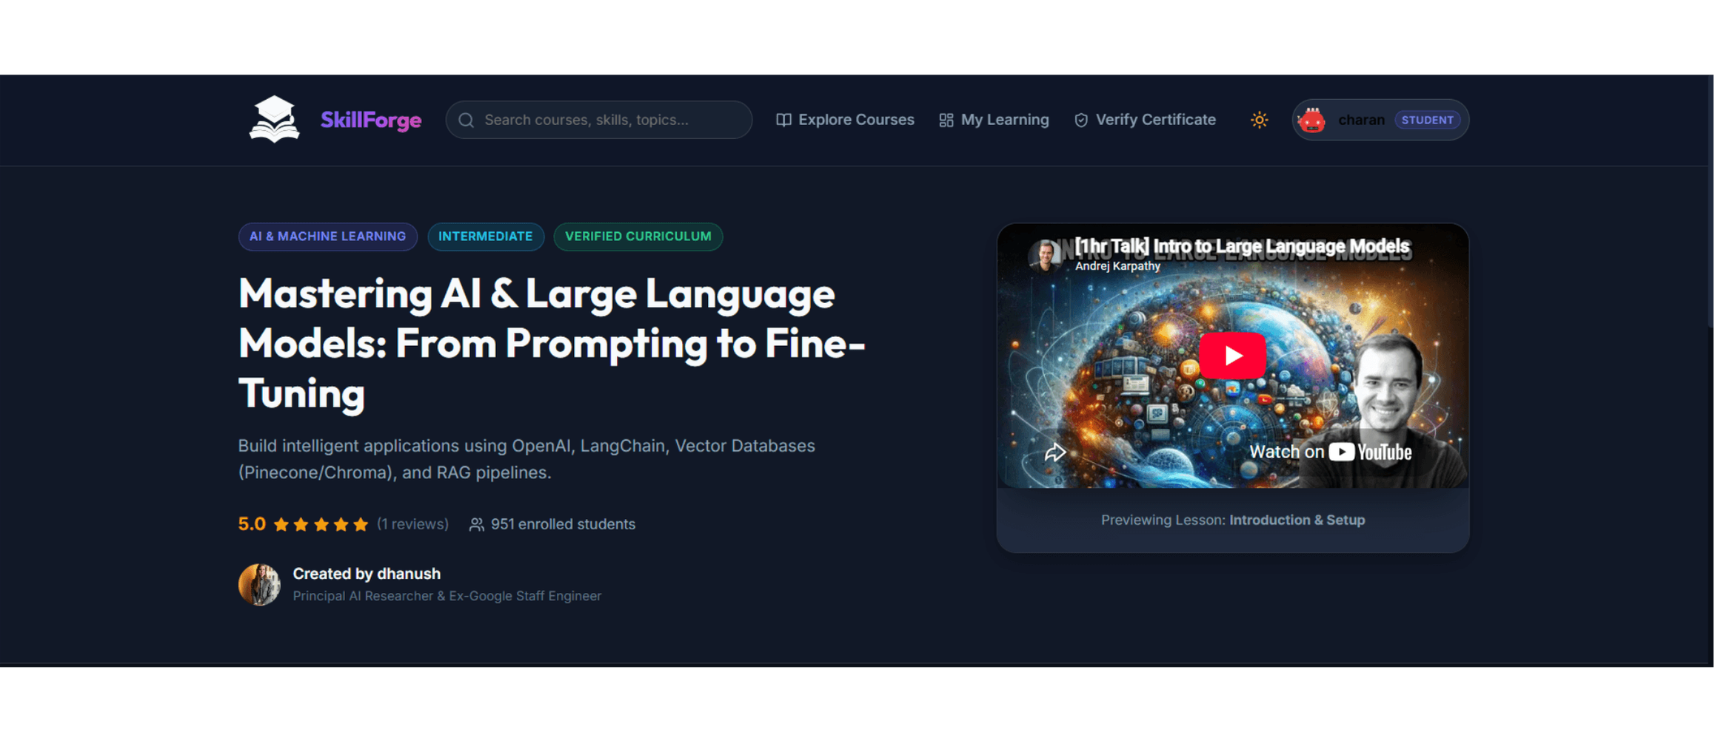
Actual Product UI: Course Discovery
LIVE IMPLEMENTATION VIEW
[ LearnHub v1.0 ]
02

Slide 3

The Problem to Solve
Fragmented Learning
Market Barriers
Disconnected platforms for content, quizzes, and certificates.
High complexity in setting up LMS infrastructure (DB, API, Storage).
Lack of synchronization between video playback and note-taking.
Opaque completion trust without verifiable public ledgers.
Manual verification of student credentials and completions.
Low engagement due to non-interactive learning experiences.
Static curriculums with limited instructor-creator control.
Restricted accessibility for small-to-medium skill creators.
[ LearnHub v1.0 ]
03

Slide 4
Project Objectives
01
Unified Platform
02
Interactive Learning
Develop a cohesive MERN-based environment for seamless content delivery, assessment, and credentialing.
Implement smart video playback, timestamped note-taking, and instant-graded quizzes for active engagement.
03
Trust & Verification
04
Creator Empowerment
Engineered verifiable digital certificates and a public ledger to authenticate educational achievements.
Build a robust Instructor Studio for course authoring, analytics, and enrollment management.
05
Zero-Config Runtime
06
Scale & Performance
Design a flexible backend that auto-configures based on environment, including in-memory database fallback.
Ensure high performance through modern Vite bundling and efficient MongoDB indexing.
[ LearnHub v1.0 ]
04

Slide 5
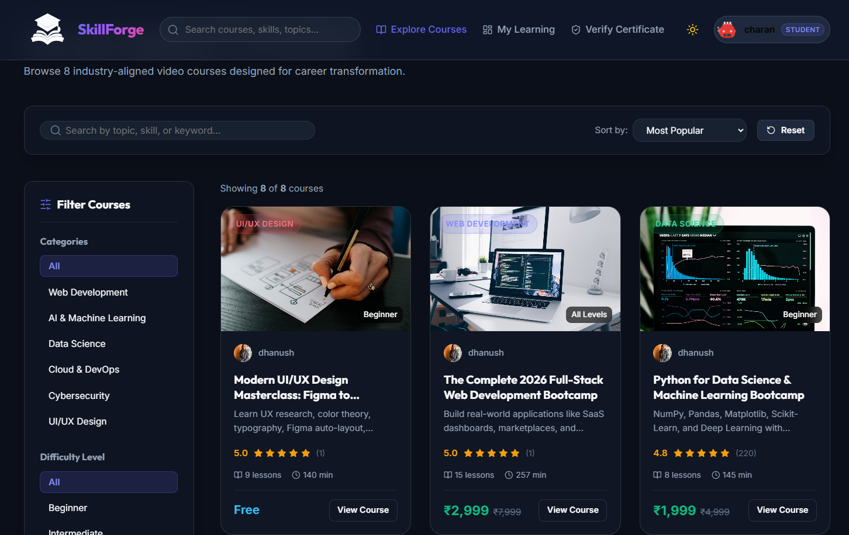
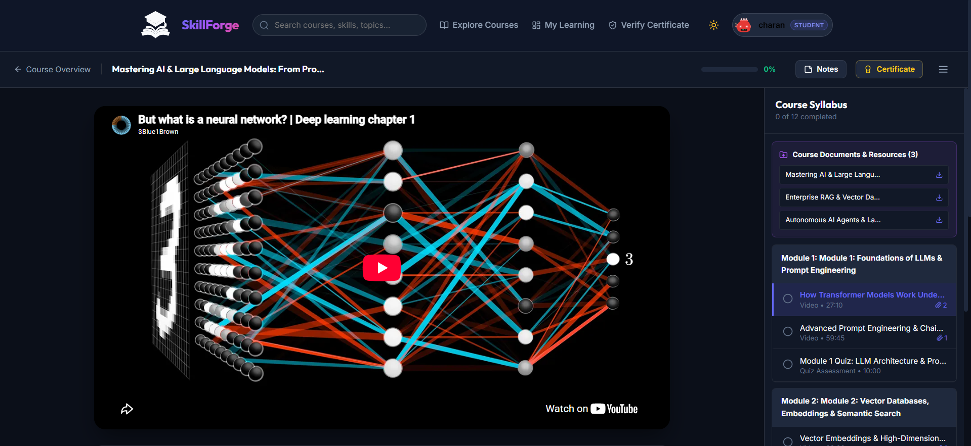
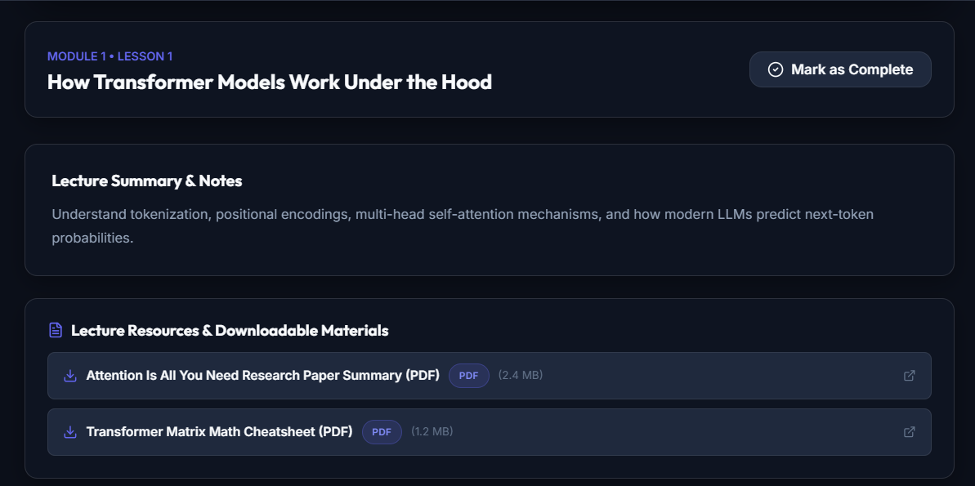
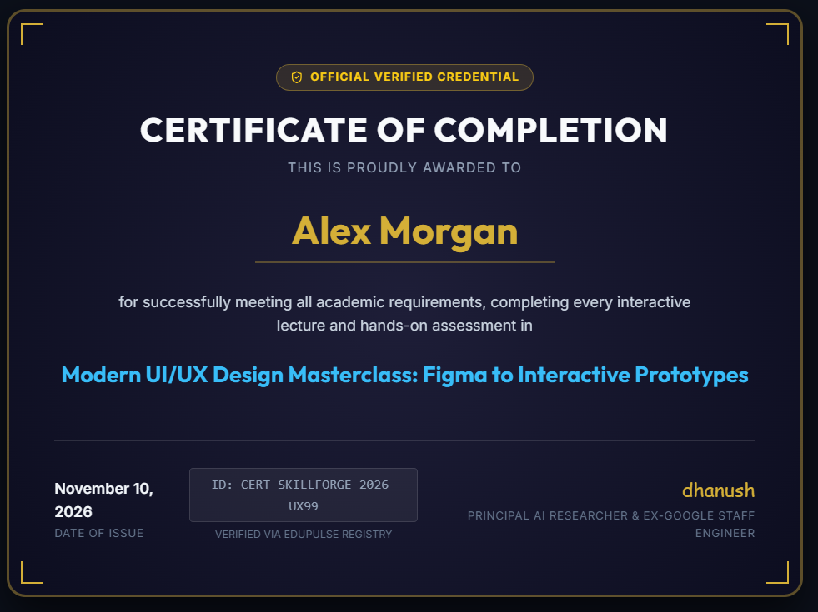
Solution Overview
SkillForge bridges the gap between static content and verified mastery through a unified MERN architecture.
The solution integrates discovery, interactive learning, assessment, and governance into a single, production-grade platform.
Course Discovery
Smart Classroom
Built for the modern web, it offers a role-aware experience for learners, instructors, and external verifiers.
Course document
Verifiable Certificates
[ LearnHub v1.0 ]
05

Slide 6
System Architecture
React 18 / Vite SPA
Context API (Auth/Theme)
CLIENT LAYER
RESTful API (Express)
JWT & Role Middleware
SERVICE LAYER
MongoDB / Mongoose
Memory Server Fallback
DATA LAYER
Frontend Engineering
Backend Services
Deployment Flex
Vite-powered SPA with responsive layouts, glassmorphism, and real-time state management using Context providers.
Modular Express server with decoupled controllers, routes, and robust authentication guards for role-based access.
Optimized for zero-config startup with auto-seeding engine and adaptive database connectivity.
[ LearnHub v1.0 ]
06

Slide 7

Interactive Learning Experience
V
Smart Video Classroom
Responsive player with speed controls (0.75x–2x), autoplay, and persistent progress tracking.
N
Timestamped Notes
Synchronized note-taking system; clicking a timestamp jumps directly to the lecture moment.
LECTURE PREVIEW
Q
Graded Quizzes
In-module assessments with instant scoring, explanations, and passing thresholds.
C
Digital Certification
Automated certificate generation with unique IDs and public verification links.
0.75x
1x
1.5x
2x
[ SkillForge v1.0 ]
06

Slide 9

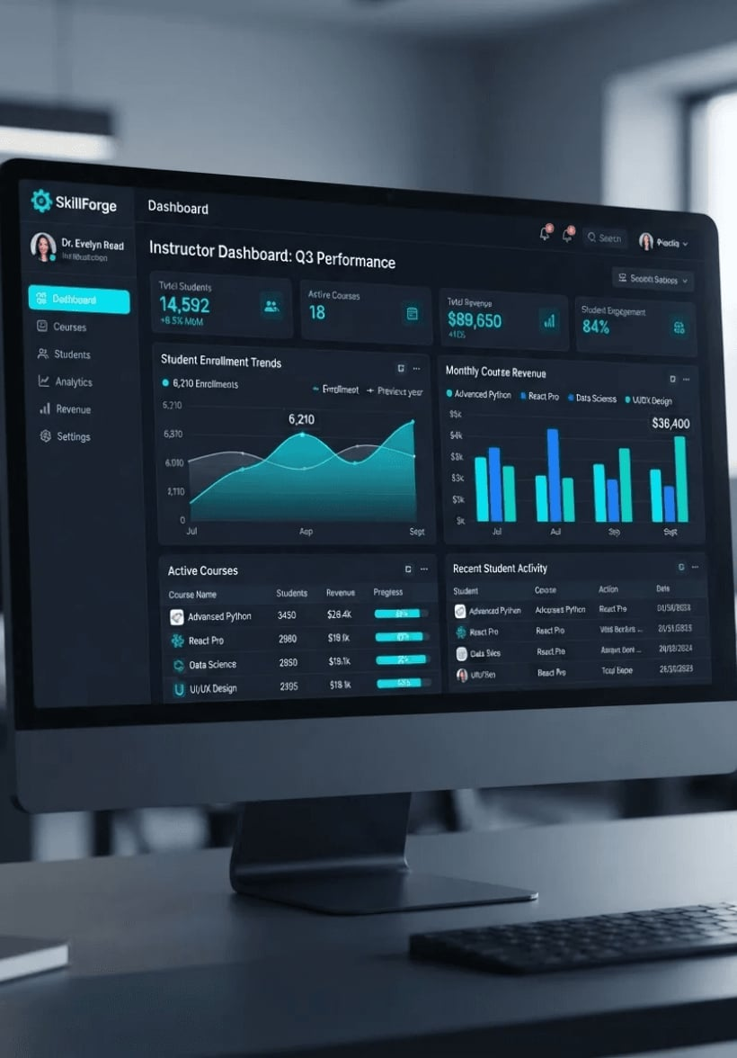
Instructor Studio & Governance
Visual Course Editor
Dynamic syllabus builder for multi-module structuring, video management, and quiz designer.
Creator Analytics
Real-time monitoring of enrolled students, revenue estimates, and learner satisfaction ratings.
Governance & RBAC
Secure Role-Based Access Control (RBAC) ensuring data integrity between student and creator roles.
Public Credential Ledger
Dedicated verification portal for authenticating unique SkillForge certificates globally.
[ LearnHub v1.0 ]
08

Slide 10
Technology Stack
FRONTEND
BACKEND
DATA & DEVOPS
React 18
Node.js / Express
MongoDB / Mongoose
Component-driven UI architecture
RESTful service orchestration
Schematic document storage
Vite 5
JWT / BcryptJS
Memory Server
Ultra-fast HMR and bundling
Secure auth & password hashing
Zero-config runtime fallback
Lucide React
Multer
Seeding Engine
Precise technical iconography
File and document upload handling
Automatic realistic mock data
Vanilla CSS
Morgan / CORS
Concurrently
Custom design system variables
Logging and resource security
Parallel dev environment runner
[ LearnHub v1.0 ]
09

Slide 11
Conclusion & Future Scope
SkillForge successfully delivers a production-grade LMS that solves the fragmentation of online learning.
Future Enhancements
1
Live Streaming Integration
The platform demonstrates a robust full-stack integration of MERN technologies with a focus on interactive engagement and verifiable trust.
Direct WebRTC / HLS support for live interactive sessions.
2
AI Learning Assistant
LLM-powered tutor for instant student Q&A and summarizing.
3
Web3 Credentialing
Result: A scalable, developer-centric solution ready for deployment and creator adoption.
Blockchain-based certificates for immutable educational records.
[ LearnHub v1.0 ]
10

Slide 12
Project Team: Digita-minds
K. Dhanush
K. Navaneeth
C. Hari Charan Reddy
B.Tech 4th Year
B.Tech 4th Year (99230040029)
B.Tech 4th Year (99230041153)
Mobile: 6281500938
Mobile: 6309691674
Mobile: 7013727214
github.com/dhanushkummara7
github.com/Navaneeth2105
github.com/charanreddyhari340
Allatipalli Vinod Babu
A. Venkata Manikanta
S. Akash
B.Tech 4th Year (99230040472)
B.Tech 4th Year (99230041151)
B.Tech 4th Year (99230040753)
Mobile: 98668 59298
Mobile: 7569537044
Mobile: 8309897147
github.com/allatipallivinodbabu
github.com/manikantayadava06
github.com/samineniakash-beep
[ LearnHub v1.0 ]
11

Slide 13
THANK YOU

